Slide 1
Introduction To JOGL
Sunirmal Khatua
Department of Computer Science & Engineering
University of Calcutta

Slide 2
What is JOGL
Java OpenGL
JOGL is a Java programming language binding for the OpenGL 3D graphics API
Java Code → JOGL → OpenGL → OS → Hardware
Supports integration with the Java platform's AWT and Swing widget sets.
Also provides platform-independent access to hardware-accelerated off-screen rendering.

Slide 3
Installing JOGL
Install JDK:
http://java.sun.com/javase/downloads/index.jsp
  After installing set PATH Environment Variable as follows:
  My Computer → Properties → Advanced → Environment Variable
  Under System Variable:
  1. Add a new variable JAVA_HOME with value of Java installation path up to the
  parent of bin.
  2. Edit Path to include %JAVA_HOME%\bin
Install Eclipse IDE:
http://www.eclipse.org/downloads/packages/eclipse-ide-java-ee-developers/ganymedesr2
Just unzip to install. You can create a shortcut to eclipe.exe
Install JOGL:
1. Download the following: 2. Unzip jogl-1.1.1-windows-i586.zip and
jogl-1.1.1-windows-i586.zip copy src & docs to that folder
jogl-1.1.1-src.zip 3. Edit the Path environment variable to include
jogl-1.1.1-docs.zip lib of the unzipped jogl folder.

Slide 4
Creating a simple Eclipse Project
Execute eclipse.exe.
Provide the path to the workspace. (First time create a new workspace)
File → New → Java Project
Enter a Project Name and click Finish. It will create a project in the left panel.
Expand your project by clicking on the project name.
Right Click on src and New → Package
Enter a package name and click Finish. This will create a package under src.
Right Click on the package and New → Class
Enter a class name, check public static void main and click Finish. This will create a Java Program under the package and the File will be opened in the middle panel.
Modify your program and save it.
Right Click on the Java Program and Run as → Java Application. This will execute the program.

Slide 5
Integrating JOGL to Eclipse Project
Create an Eclipse project.
Create a folder called lib under the project.
Copy jogl.jar & glugen-rt.jar from the lib of jogl to the lib of your project.
Right click on your Project.
Properties → Java Build Path → Libraries → Add External Jars. Add the files jogl.jar and glugen-rt.jar.
For both the jar Expand the jar and do the following:
1. Source Attachment → Edit. Select the jogl-1.1.1-src.zip and click ok.
2. Javadoc location → Edit. Select the jogl-1.1.1- docs.zip and click ok.
3. Native library location → Edit. Select the lib of jogl and click ok.
Finally click OK to complete the integration.

Slide 6
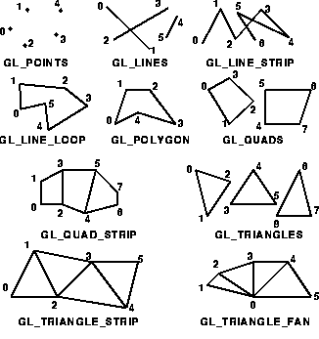
OpenGL Primitive Types

Slide 7
Defining OpenGL Primitive
glBegin(GL_PRIMITIVE_TYPE)
glVertex();
glVertex();
glEnd();

Slide 8
OpenGL Transformation Functions
glLoadIdentity()
glTranslate(TYPE x, TYPE y, TYPE z)
glRotate(TYPE angle, TYPE x, TYPE y, TYPE z)
glScale(TYPE x, TYPE y, TYPE z)
glPushMatrix()
glPopMatrix()

